Slide 1


Presentation on
Picard’s Method for numerical differentiation

Slide 2
Presented to
Presented by
Rahat Kabir(D-53[49])
Montaka Sadia(D-53[13])
Nahidul Sajal(D-52[28])
RAFID MOSTAFIZ
Lecturer, Department Of CSE
Dhaka International
University

Slide 3
TITLE OF CONTENTS
Introduction
Picard’s iteration method formula
Steps Involved
Picard Iteration Example
Solution
Program for Picard’s Iterative Method

Slide 4
Introduction
This method of solving a differential equation approximately is one of successive approximation; that is, it is an iterative method in which the numerical results become more and more accurate, the more times it is used.

Slide 5

Picard’s iteration method formula:

Slide 6
Steps Involved
Step 1: An approximate value of y (taken, at first, to be a constant) is substituted into the right hand side of the differential equation: dy/dx= f(x, y)
Step 2: The equation is then integrated with respect to x giving y in terms of x as a second approximation, into which given numerical values are substituted and the result rounded off to an assigned number of decimal places or significant figures.
Step 3: The iterative process is continued until two consecutive numerical solutions are the same when rounded off to the required number of decimal places.

Slide 7

Picard iteration Example:

Slide 8


Solution
You may proceed as below
where x0 = 0. Hence:

Slide 9

Solution
where y0 = 0. which becomes:
First Iteration: We do not know y in terms of x yet, so we replace y by the constant value y0 in the function to be integrated.The result of the first iteration is thus given, at x = 0.3, by:

Slide 10


Solution
Second Iteration: Now, we use:
Therefore,

Slide 11


Solution which gives:
The result of the second iteration is thus given by:
at x=0.3.

Slide 12
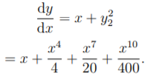

Solution
Third Iteration: Now, we use:
Therefore,

Slide 13


Solution which gives:
The result of the second iteration is thus given by:
at x=0.3.
Hence, y = 0.0451, correct upto four decimal places, at x = 0.3.

Slide 14
Program for Picard’s Iterative Method
1 // C program for Picard's iterative method
2
3 #include <math.h>
4 #include <stdio.h>
5 #define Y1(x) (1 + (x) + pow(x, 2) / 2)
6 #define Y2(x) (1 + (x) + pow(x, 2) / 2 + pow(x, 3) / 3 + pow(x, 4) / 8)
7 #define Y3(x) (1 + (x) + pow(x, 2) / 2 + pow(x, 3) / 3 + pow(x, 4) / 8 + pow(x, 5) / 15 + pow(x, 6) / 48)
8
9 int main()
10 {
11 double start_value = 0, end_value = 3,
12 allowed_error = 0.4, temp;
13 double y1[30], y2[30], y3[30];
14 int count;
15
16 for (temp = start_value, count = 0;
17 temp <= end_value;
18 temp = temp + allowed_error, count++) {
19
20 y1[count] = Y1(temp);
21 y2[count] = Y2(temp);
22 y3[count] = Y3(temp);
23 }
25 printf("\nX\n");
26 for (temp = start_value;
27 temp <= end_value;
28 temp = temp + allowed_error) {
29
30 printf("%.4lf ", temp);
31 }
32
33 printf("\n\nY(1)\n");
34 for (temp = start_value, count = 0;
35 temp <= end_value;
36 temp = temp + allowed_error, count++) {
37
38 printf("%.4lf ", y1[count]);
39 }
40
41 printf("\n\nY(2)\n");
42 for (temp = start_value, count = 0;
43 temp <= end_value;
44 temp = temp + allowed_error, count++) {
45
46 printf("%.4lf ", y2[count]);
47 }
48
49 printf("\n\nY(3)\n");
50 for (temp = start_value, count = 0;
51 temp <= end_value;
52 temp = temp + allowed_error, count++) {
53
54 printf("%.4lf ", y3[count]);
55 }
56 return 0;
57 }

Slide 15
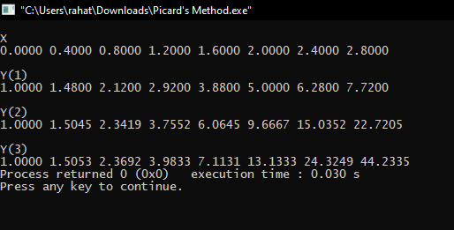
Output

Slide 16
THANK YOU ALL

